Slide 1

Department of CSE-AI & ML (CSM)
Team:BATCH6
21BQ1A42F1, 22BQ5A4217,
21BQ1A42G6, 22BQ5A4218
Project Title:
Yoga Pose Detection System Using Deep Learning for Yoga Pose Detection and Feedback
TEAM MEMBERS:
21BQ1A42F1 – R. Pavan Kumar
21BQ1A42G6 – S. Nandini
22BQ5A4217 – Sk. Nayeem
22BQ5A4218 – Sk. Baji Baba
Under the Guidance of:
(Project Guide) HOD-CSM,
K. Sireesha Dr.K.Suresh Babu

Slide 2
Department of CSE-AI & ML (CSM)
Team:BATCH6
21BQ1A42F1, 22BQ5A4217,
21BQ1A42G6, 22BQ5A4218
Abstract:
The Yoga Pose Detection System is a web-based platform that leverages Deep Learning to accurately identify and analyze yoga poses. Using advanced models like MobileNet, VGG16, and DenseNet, the system provides real-time pose detection, feedback, and personalized recommendations. It enables users to upload images or use webcams to receive immediate corrections on pose accuracy. The system also includes features such as user authentication with OTP verification, yoga pose search, sentiment analysis on feedback, and an admin dashboard for tracking user activity. The platform aims to offer a seamless yoga learning experience, improving user’s alignment and overall practice with dynamic tools for engagement and progress monitoring.

Slide 3
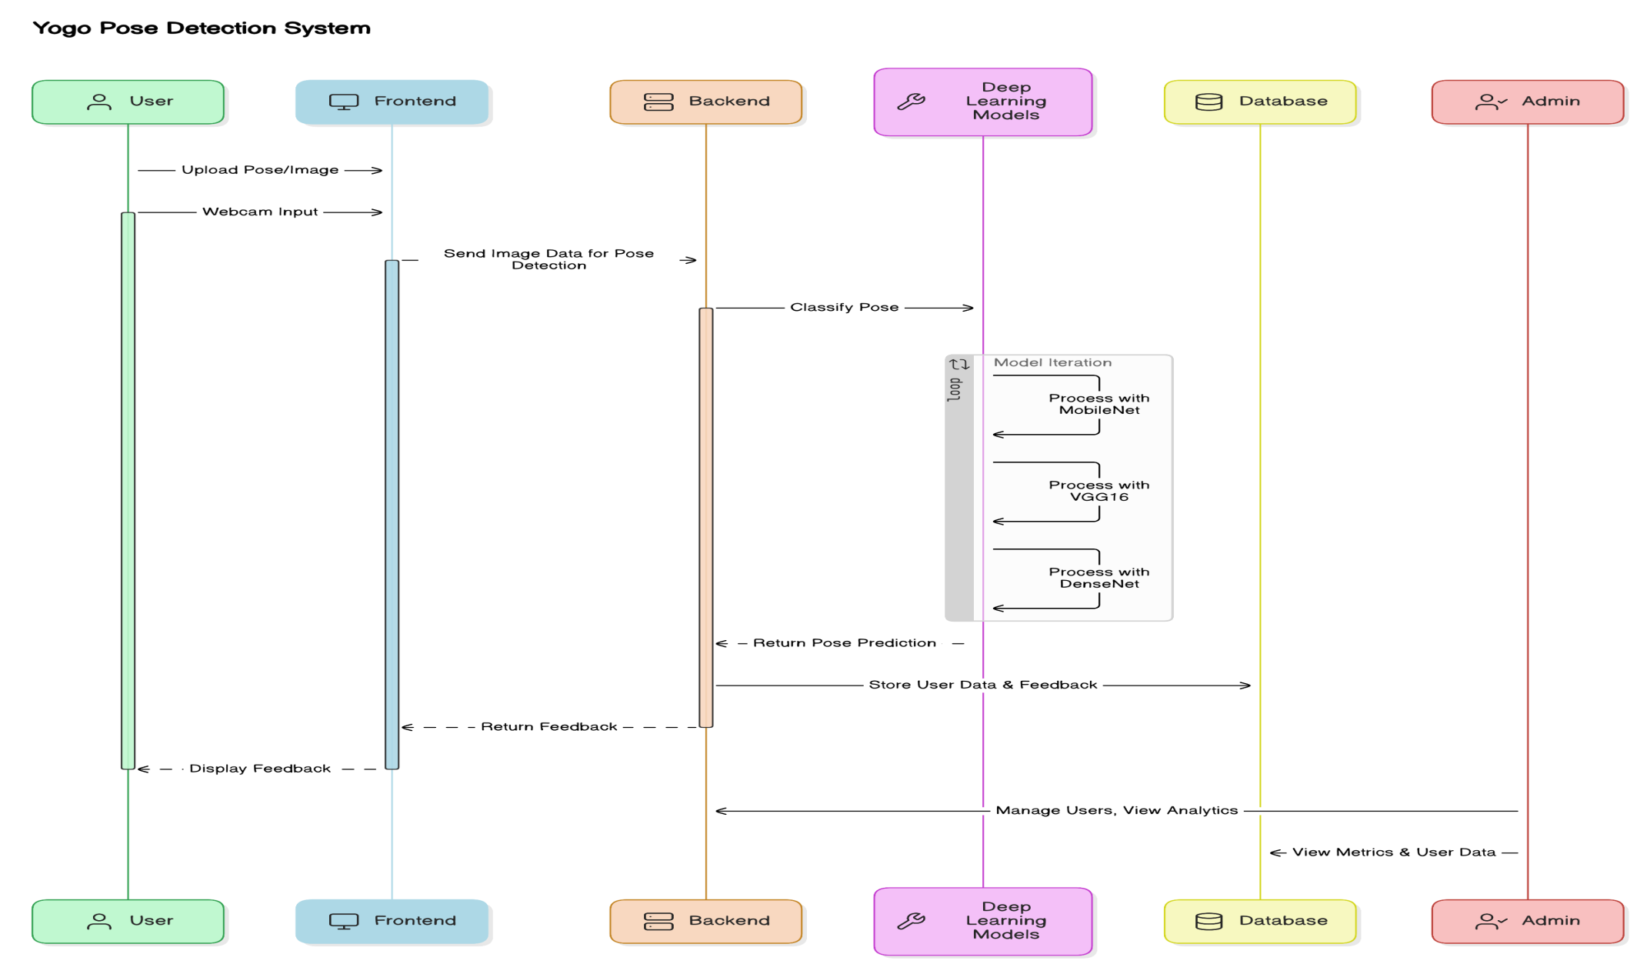
Department of CSE-AI & ML (CSM)
Team:BATCH6
21BQ1A42F1, 22BQ5A4217,
21BQ1A42G6, 22BQ5A4218
System Architecture

Slide 4
Department of CSE-AI & ML (CSM)
Team:BATCH6
21BQ1A42F1, 22BQ5A4217,
21BQ1A42G6, 22BQ5A4218
Proposed Solution
The Yoga Pose Detection System leverages Deep Learning and Computer Vision to provide real-time yoga pose detection and feedback, offering users an interactive way to improve their practice. By utilizing models like MobileNet, VGG16, and DenseNet, the system accurately predicts and classifies yoga poses based on images or webcam inputs. Key features include user and admin authentication with OTP verification, real-time pose detection, and pose recommendations based on health goals. Additionally, the system offers a yoga pose search interface with detailed instructions and tutorials, sentiment analysis on user feedback, and an admin dashboard for tracking metrics and progress. The proposed solution aims to provide users with a seamless, interactive yoga learning experience, improving posture, alignment, and overall fitness.
Functional Requirements
Yoga Pose History and Tracking:
Maintain a comprehensive history of yoga poses, allowing users to review previous poses and feedback.
Implement search and filter functionality to find specific poses and track improvements over time.
Allow users to add notes or comments to individual pose entries for better tracking of their progress and adjustments.
Provide a timeline view to visualize users' yoga practice and alignment improvements.

Slide 5
Department of CSE-AI & ML (CSM)
Team:BATCH6
21BQ1A42F1, 22BQ5A4217,
21BQ1A42G6, 22BQ5A4218
Goals Setting and Tracking:
Enable users to set specific yoga-related goals (e.g., flexibility improvement, pose accuracy).
Provide progress tracking with visual indicators to show achievements in pose accuracy and alignment.
Send periodic progress updates, congratulating users on milestones and improvements.
Allow users to update goals based on performance and practice.
Offline Functionality:
Implement offline access for users to practice poses and view previous feedback without an internet connection.
Sync data with the cloud when the connection is restored, ensuring data is up-to-date.
Offer real-time feedback and suggestions even in offline mode for uninterrupted practice.
Store user settings and preferences locally for a seamless experience when offline.

Slide 6
Department of CSE-AI & ML (CSM)
Team:BATCH6
21BQ1A42F1, 22BQ5A4217,
21BQ1A42G6, 22BQ5A4218
Software Requirements
UI Design: Figma
Development Environment: Visual Studio Code
Programming Languages: Python (Django), JavaScript (React)
Deep Learning Frameworks: TensorFlow, Keras
Database: SQLite3
Model Training: Jupyter Notebooks
Real-Time Processing: OpenCV
Version Control: GitHub
Cloud Services: AWS (for deployment and scalability)
Communication: Email OTP for user authentication
User Activity Tracking: Google Analytics
Feedback Analysis: Python’s NLTK (Natural Language Toolkit)
API Testing: Postman

Slide 7
Department of CSE-AI & ML (CSM)
Team:BATCH6
21BQ1A42F1, 22BQ5A4217,
21BQ1A42G6, 22BQ5A4218
Hardware Requirements
Operating System: Windows 10 or above / macOS for development
RAM: 8GB or higher
Storage: 500GB HDD or SSD
Graphics: Integrated graphics or dedicated GPU (for real-time pose detection)
Internet Speed: 10Mbps or higher (for cloud data syncing, API requests, and real-time video processing)
Camera: 720p or higher resolution webcam for real-time pose detection

Slide 8
Department of CSE-AI & ML (CSM)
Team:BATCH6
21BQ1A42F1, 22BQ5A4217,
21BQ1A42G6, 22BQ5A4218
Results:
The Yoga Pose Detection System is designed to enhance user’s yoga practice by providing real-time pose detection, personalized feedback, and progress tracking. The system integrates MobileNet, VGG16, and DenseNet deep learning models to predict yoga poses with high accuracy, offering immediate feedback on pose correctness and alignment. Key features like yoga pose search, sentiment analysis on user feedback, and admin dashboards for tracking metrics contribute to an engaging user experience. The system's real-time webcam detection allows users to practice interactively and receive ongoing corrections, ensuring continuous improvement.
With accurate predictions and actionable feedback, users can track their progress and set goals, while pose recommendations based on health benefits help users enhance their practice. The platform also supports user and admin authentication, providing secure access to personalized content and data. Overall, the system creates a comprehensive and seamless yoga learning experience for users at all levels, encouraging long-term engagement and improved well-being.

Slide 9

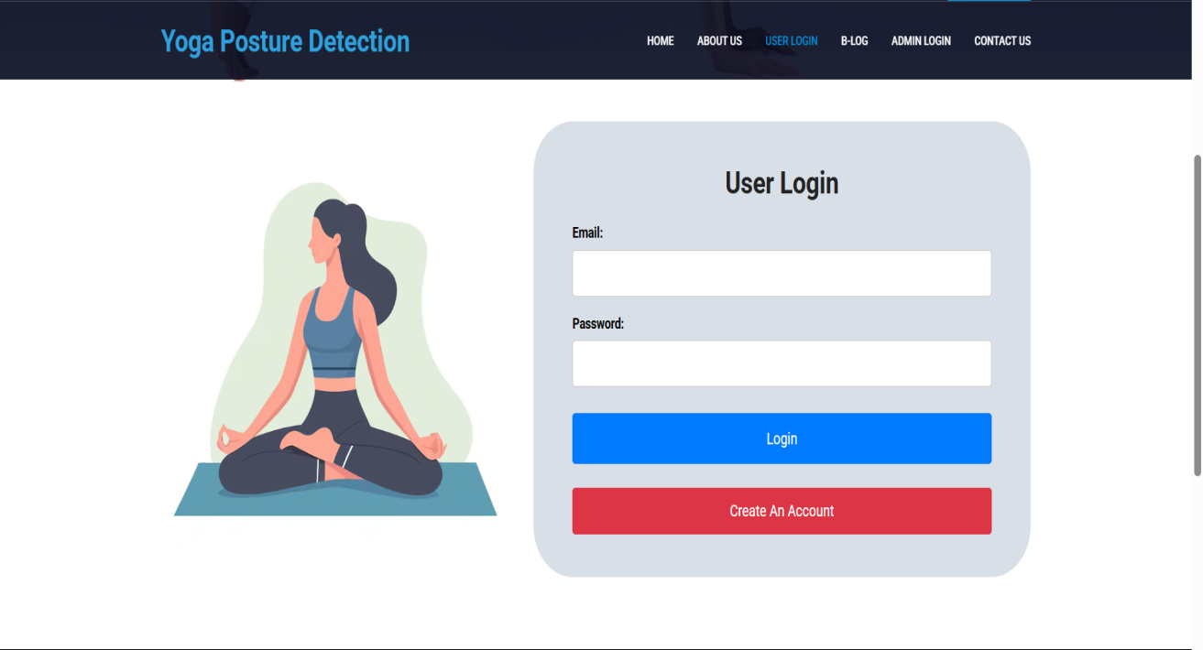
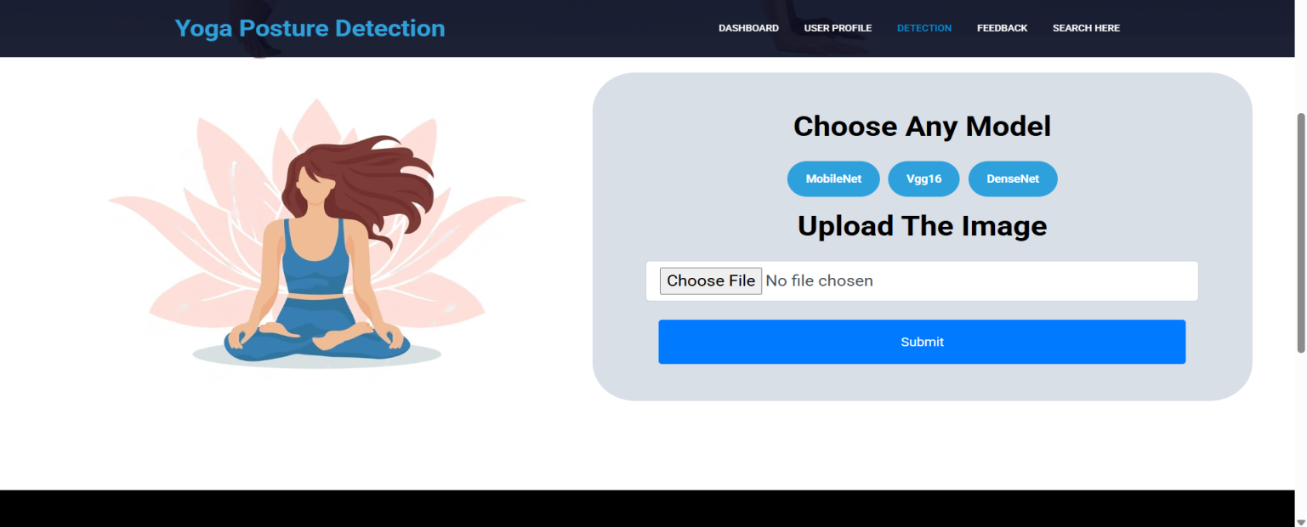
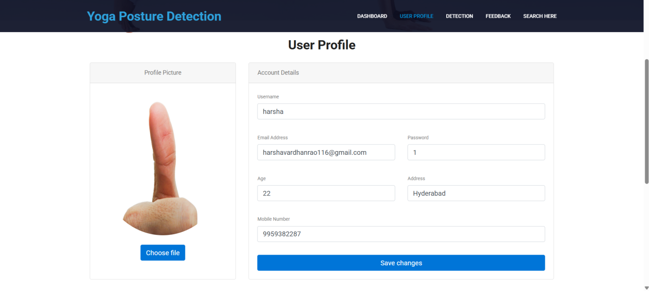
Department of CSE-AI & ML (CSM)
Team:BATCH6
21BQ1A42F1, 22BQ5A4217,
21BQ1A42G6, 22BQ5A4218

Slide 10
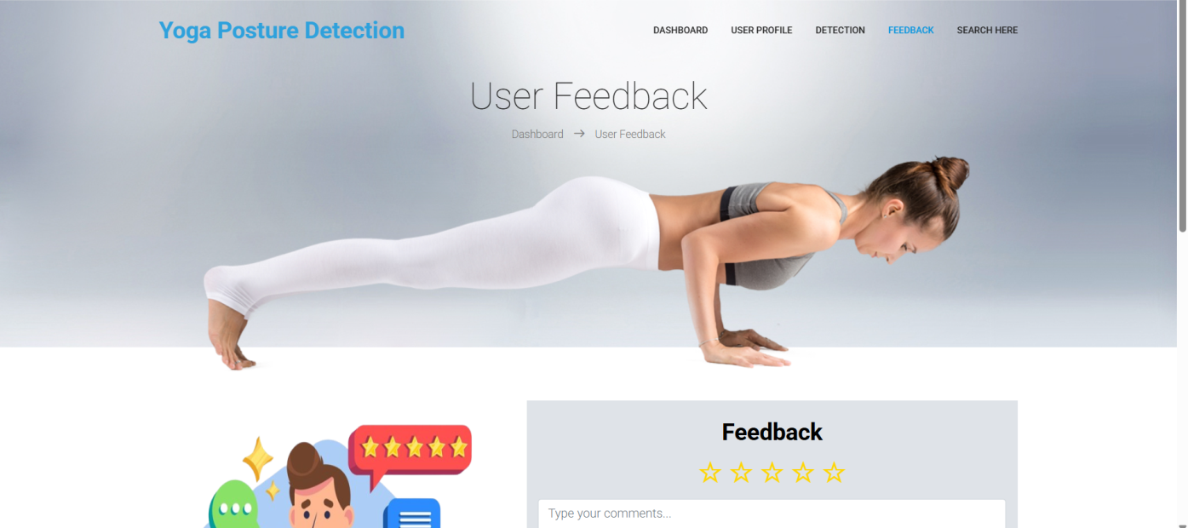
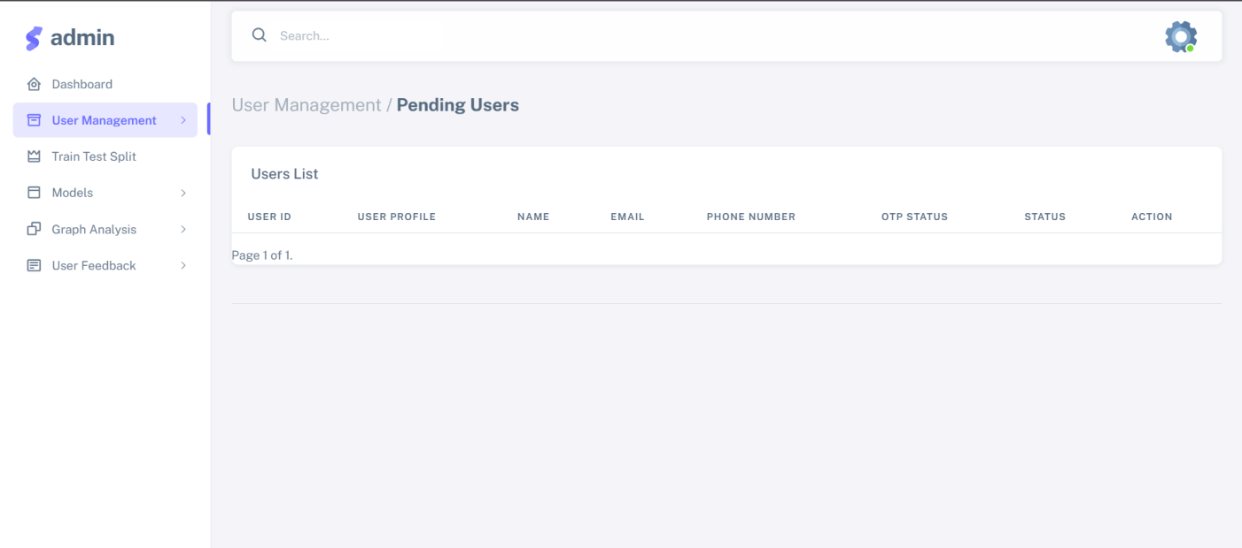
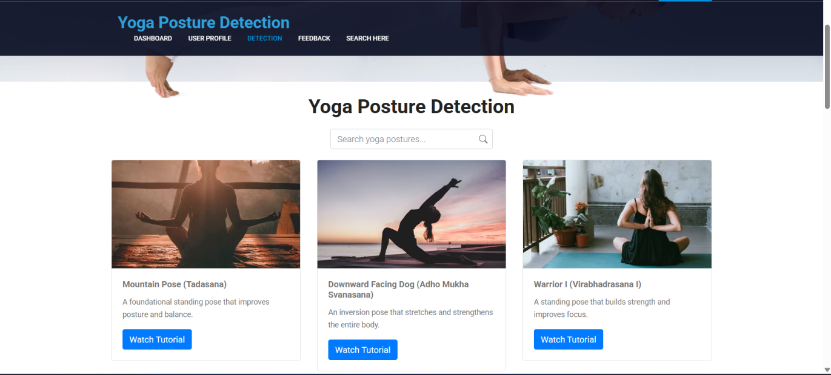
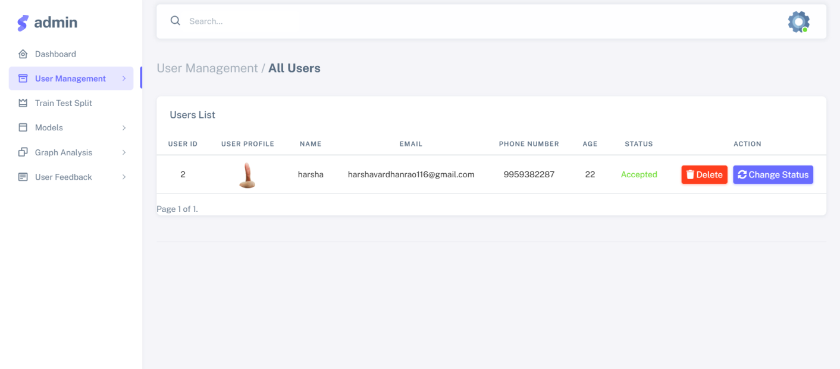
Department of CSE-AI & ML (CSM)
Team:BATCH6
21BQ1A42F1, 22BQ5A4217,
21BQ1A42G6, 22BQ5A4218

Slide 11
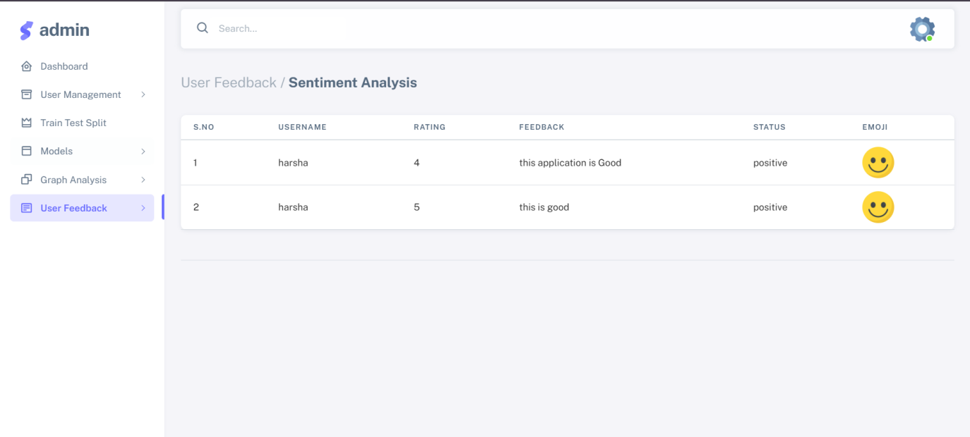
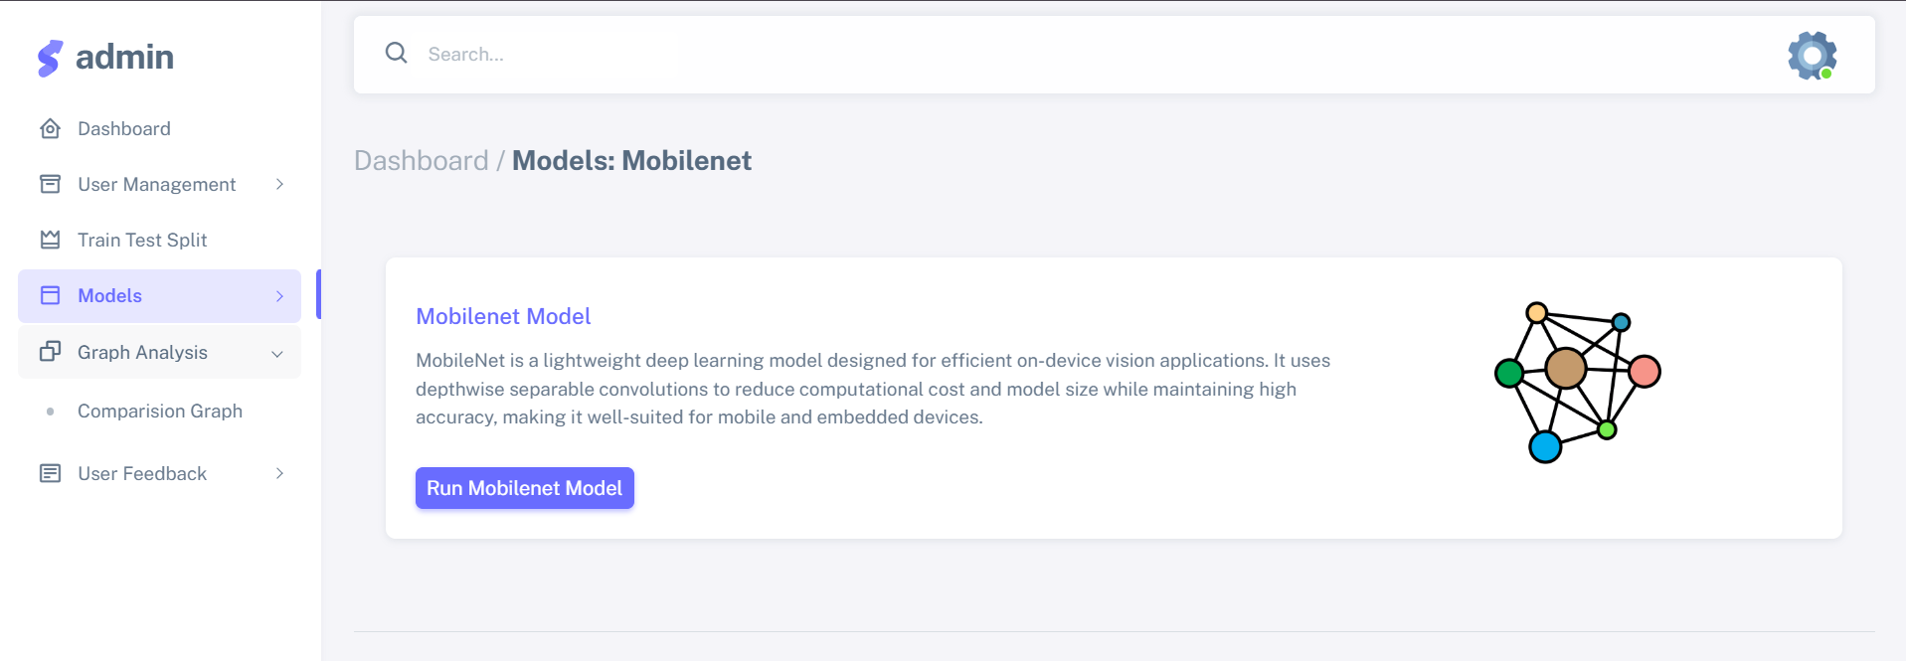
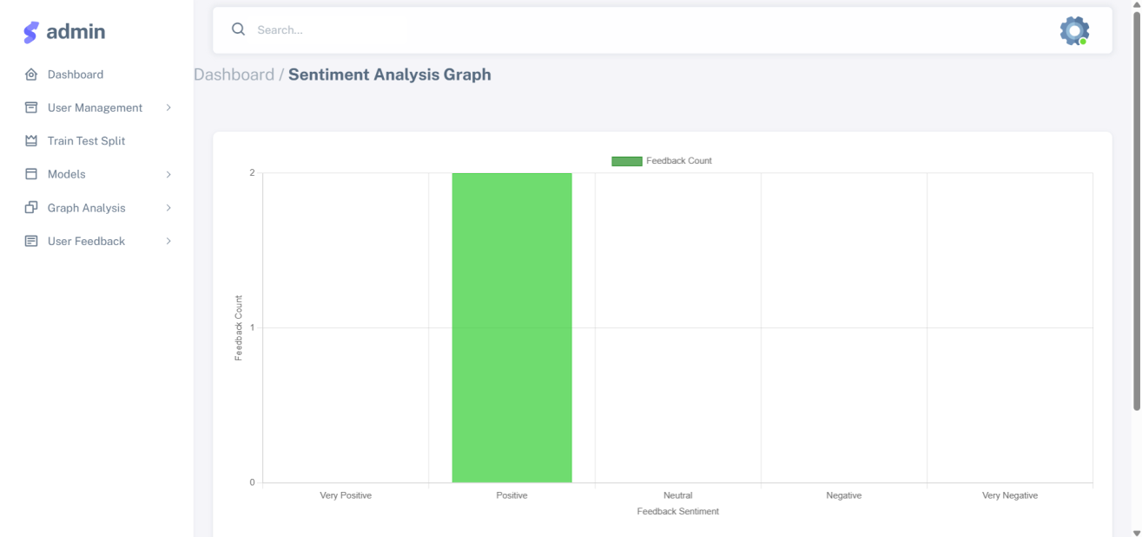
Department of CSE-AI & ML (CSM)
Team:BATCH6
21BQ1A42F1, 22BQ5A4217,
21BQ1A42G6, 22BQ5A4218

Slide 12
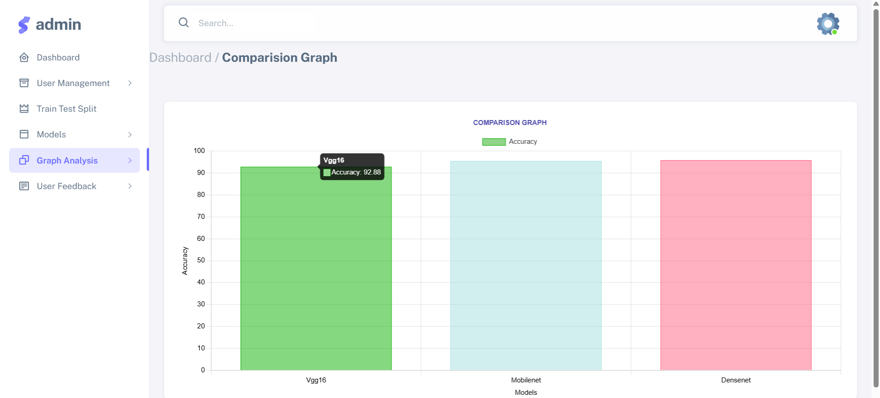
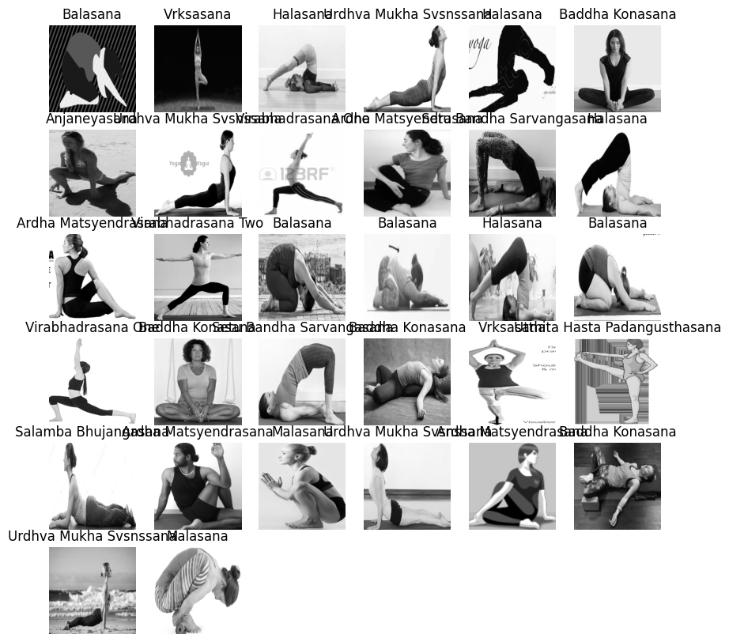
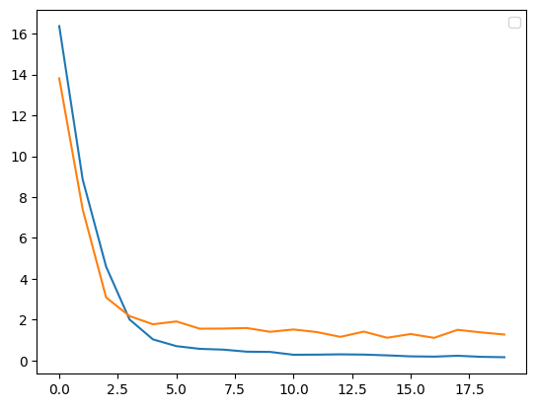
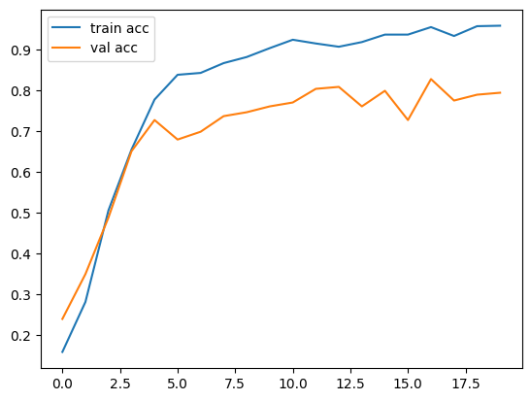
Department of CSE-AI & ML (CSM)
Team:BATCH6
21BQ1A42F1, 22BQ5A4217,
21BQ1A42G6, 22BQ5A4218

